Slide 1

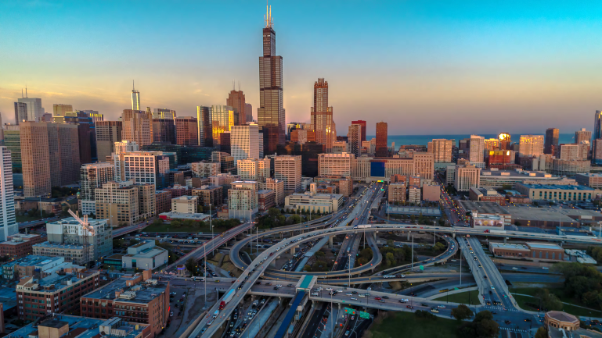
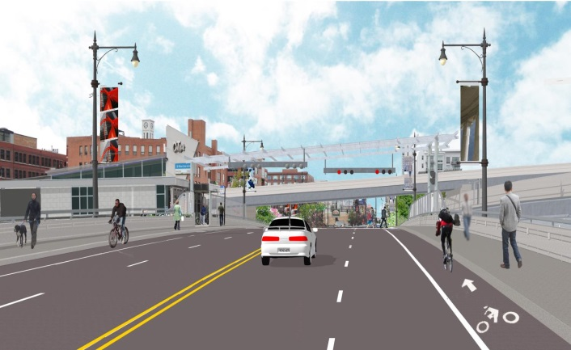
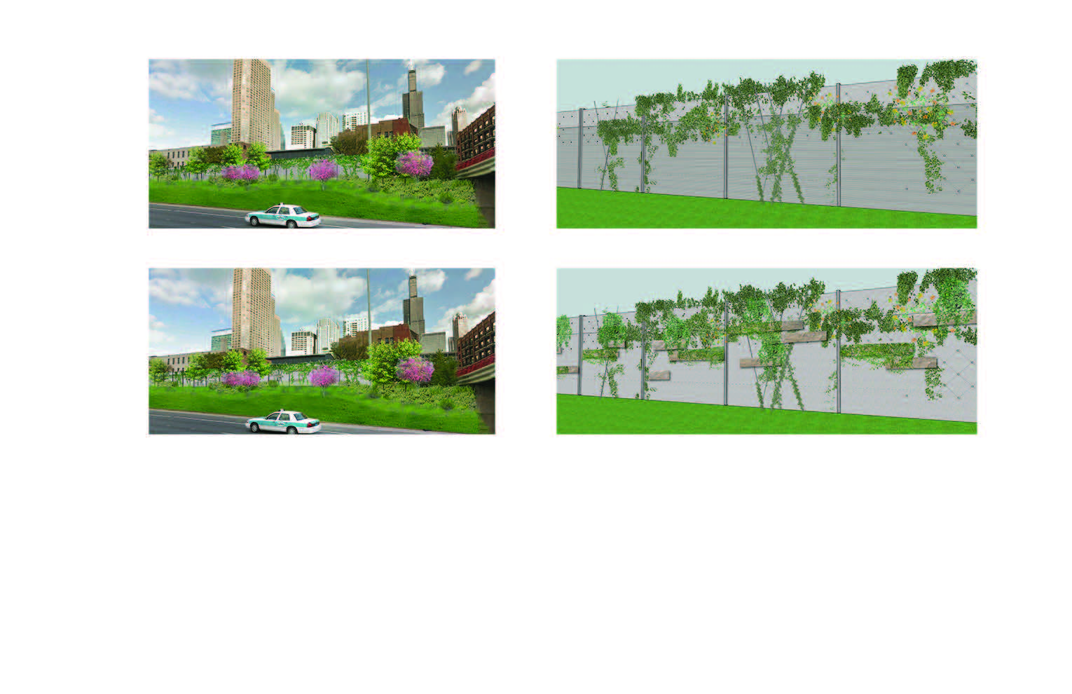
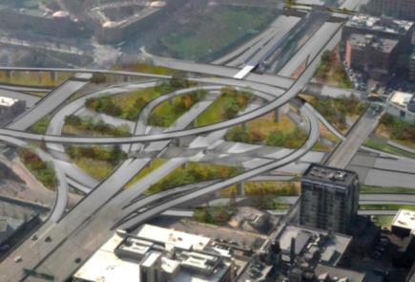
I-290 EB Ramp to I-90/94 (NB) - Contract #60X79
Misc. Interchange Ramps at Various Locations -
Contract #60X93
November 9, 2018 Letting
Pre-Bid Meeting
OCTOBER 18, 2018 – 10:00 AM

Slide 2
Pre-Bid Meeting Agenda
Welcome and Introductions
Projects Overview
Major Construction Items
Suggested Staging
CTA and Utility Coordination
DBE Requirements
Questions / Comments
The contents of this presentation slides are intended for information purposes only & clarification of the contract documents for bidders and are not intended to supersede the requirements and contents of the posted contract documents available on the Department’s website for bidding purposes.

Slide 3
Scope of Work Summary
Contract 60X79………………………………………………………...
Contract 60X93…………………… ……………………...
December 18, 2020 Completion Date + 40 Working Days for Retaining Wall, Pier Improvements & CTA Bus Turnaround, clean up & punch list | One Proposed Bridge One Bridge Pier Modification Two MSE Walls Approaches One Longitudinal MSE Wall Two Drilled Shaft / Conc. Walls Main Drain Improvements
December 18, 2020 Completion Date + 10 Working Days for Misc. items / punch list & clean up. | Five Bridges Three MSE Wall Approaches One soldier Pile/Conc.&MSE Wall One Longitudinal MSE Wall One Existing Wall Repair

Slide 4
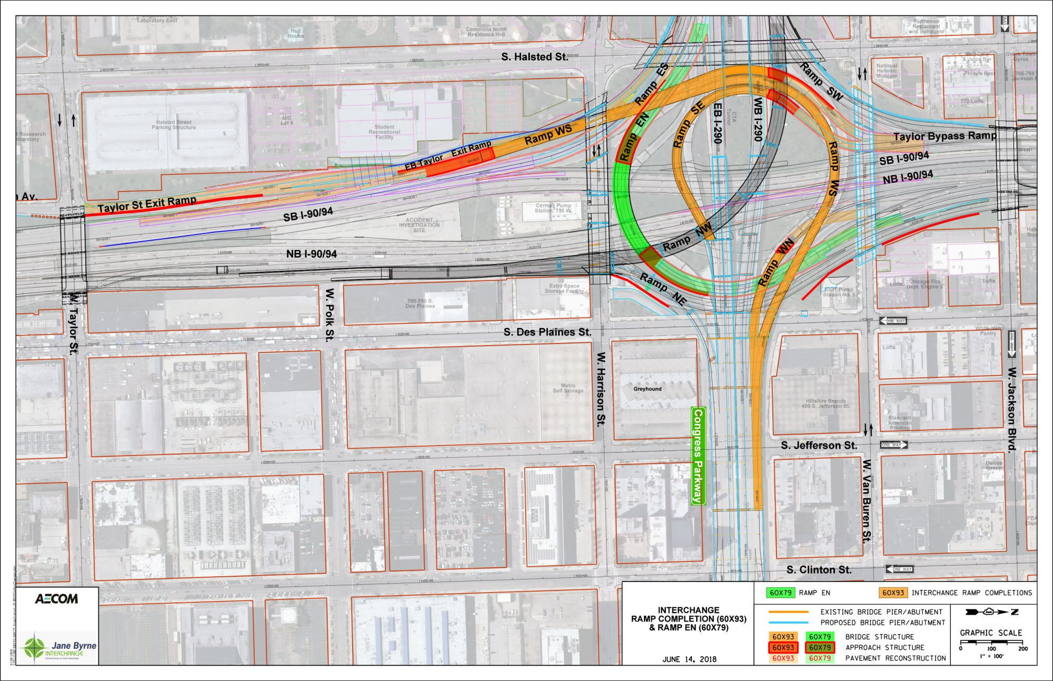
Project Overview
60X93 - Misc. Interchange Ramps at Various Locations
  SN 016-2311 (Ex. Retaining Wall #12)
  Concrete Cantilever Wall with Moment Slab
  Along EB Taylor Exit Ramp
  Ex. Retaining wall Repair, Partial Removal and Parapet/Moment Slab Construction
  Wall – 595’ Length
N
  SN 016-1805 (Retaining Wall #16)
  MSE Wall – 579.5’; 7,432 SF; 5,618 CY of Lightweight Fill
  SN 016-1715 – Ramp WS Bridge Over I-90/94/290
  Steel Superstructure – 1925.8’ Long, 17 Spans
  16 Piers + 1 Abutment
  East End at Pier C2 – SN 016-0461
  41 Drilled Shafts
  Combination Straddle Bent and Hammerhead Piers
  SN 016-1803 (Retaining Wall #14)
  Tied to South Abutment of Ramp WS
  22 Drilled Soldier Piles – 185’ Length
  1,603 CY of Expanded Polystyrene Fill
  MSE Wall – 255.5’; 2,394 SY; 1,447 CY of Lightweight Fill

Slide 5
Project Overview
60X93 - Misc. Interchange Ramps at Various Locations
N
  SN 016-1706 – Ramp WN Bridge Over I-90/94, C-D Road, and Ramp EN
  Steel Superstructure – 222’ Long, 3 Spans
  2 Piers + 1 Abutment
  East End at Pier C1 – SN 016-0461
  5 Drilled Shafts
  SN 016-0461 – WB I-290 Viaduct Over
  Des Plaines St to Canal St
  New Steel Superstructure – 239’ Long, 3 Spans
  Modify/Reconstruct 3 piers (C1, C2, C4)
  1 Drilled Shaft
  Repairs of Existing Substructure
  Remove and Replace 20,151 SF of Deck
  SN 016-1833 (Retaining Wall #46)
  Wrapped around North Abutment of Ramp WN Bridge
  MSE Wall – 579.5’; 347 SF; 176 CY of Lightweight Fill

Slide 6
Project Overview
60X93 - Misc. Interchange Ramps at Various Locations
N
  SN 016-1714 – Ramp SE Bridge Over I-90/94/290
  Steel Superstructure – 740.8’ Long, 8 Spans
  7 Piers + 1 Abutment
  20 Drilled Shafts
  SN 016-1835 (Retaining Wall #48)
  Tied to North Abutment of Ramp SE bridge
  MSE – 199.2’; 2,260 SF; 8,790 CY of Lightweight Fill
  Aggregate Column Ground Improvement
  Connection at Pier #2 of EB I-290 over I-90/94
  (Contract 60X75)

Slide 7
Project Overview
60X93 - Misc. Interchange Ramps at Various Locations
N
  Shared Pier 11 of Ramp WS
  SN 016-1718 – SB Taylor Street Exit Ramp Bridge
  2 Piers + 1 Abutment
  8 drilled shafts (Pier 11 not included)
  Steel Superstructure – 152’ Long, 2 Spans
  SN 016-1834 (Retaining Wall #47)
  Tied to North Abutment of SB Taylor St Exit Ramp Bridge
  MSE – 358.8’; 3,810 SF; 2,678 CY of Lightweight Fill
  Aggregate Column Ground Improvement

Slide 8
Contracts 60X79 & 60X93
60X79 - I-290 EB Ramp to I-90/94 (NB)–Bridge
  SN 016-1712 – Ramp EN Bridge Over I-90/94
  Steel Superstructure – 313.8’ Long, 3 Spans
  4 Drilled Shafts at West Abutment
  16 Micro-Piles at Pier #1
  4 Drilled Shafts at Pier #2
  16 Piles at East Abutment
  Construction of the majority of the substructure while existing bridge is operational
N
  SN 016-1710 – Ramp NE Bridge Pier #1 Modification
  Addition of one new drilled shaft and column
  Extension of existing straddle bent cap
  Removal of existing column and partial drilled shaft after completion of cap
  Construction within close proximity to Retaining Wall 22A (SN 016-1813) during/after wall construction

Slide 9
Contracts 60X79 & 60X93
60X79 - I-290 EB Ramp to I-90/94 (NB)–Retaining Walls
  SN 016-1807 (Retaining Wall #18)
  Wrapped Around the West Abutment of Ramp EN Bridge
  MSE – 451.8’; 4,597 SF; 3,217 CY of Lightweight Fill
N
  SN 016-1811 (Retaining Wall #20)
  Wrapped Around the East Abutment of Ramp EN Bridge
  MSE – 374.7’; 4,694 SF; 3,282 CY of Lightweight Fill
  SN 016-1813 (Retaining Wall #22A)
  Along Future NB C-D Road (I-90/94) north of Harrison Street Bridge
  MSE – 220’; 3,290 SF; 5,200 CY of Lightweight Fill
  SN 016-1839 (Retaining Wall #22B)
  South of Van Buren St Bridge
  Wall – 212’-10”; 3,530 SF; 1,454 CY of LWF
  22 Drilled Soldier Piles in Soil After Main Drain Improvements
  SN 016-1814 (Retaining Wall #23)
  North of Van Buren Street Bridge
  Wall – 332’-9”
  33 Drilled Soldier Piles in Soil (After Filling Abandoned CTA Water Tunnel)

Slide 10
Contracts 60X79 & 60X93
60X79 - I-290 EB Ramp to I-90/94 (NB)–Major Drainage
  West Main Drain along SB I-90/94:
  335’ Jacked in Place Sewer – 60” Dia.
  70’ Open Trench Sewer – 78”Dia.
N
  Under NB and SB I-90/94:
  165’ Jacked in Place Sewer - 78” Dia.
  Junction Chamber No. 2
  Built to Provide Access to Existing 4.5’ x 5’ Arch Elliptical Main Drain +/- 25’ Deep to Invert
  Under Proposed Ramp EN and WN:
  158’ Open Trench Sewer - 78” Dia.
  Junction Chamber No. 1
  13.5’ x 13.5’ Structure Connecting Proposed 78” and 48” Sewers to Existing 7.2’ x 8’ Arch Elliptical Main Drain +/- 24’ Deep to Invert
  Also Modification to Existing Structure
  Built During Ret. Wall No. 22B Excavation
  East Main Drain along NB I-90/94:
  126’ Jacked in Place Sewer - 48” Dia.
  361’ Open Trench Sewer - 48” Dia.

Slide 11
Assumed Adjacent Projects at Start of Construction (Tentatively Feb 2019)
Retaining Wall and Water Main Near UIC (62A74)
Van Buren Street Bridge Reconstruction (60X99)
WB I-290 Reconstruction (60X77)
EB I-290 Bridges (60X75)
Monroe Street Bridge Reconstruction (60X95)
EB I-290 Pavement and Retaining Walls (60X76)
Refer to Contractor Cooperation Special Provisions

Slide 12
Contract 60X79 and 60X93
Anticipated Project Schedule
General Schedule & Estimated Dates
(Subject to Contractor’s Schedule)
Letting Date – November 9, 2018
Anticipated Start of Construction: Late February/Early March 2019
WINTER WORK IS ALLOWED (With Winter Protection – No Separate Payment)
Various Interim Dates for Ramp Closures/Openings (Refer to Special Provisions)
Various Ramp Closure Durations (Refer to Special Provisions)
Contract 60X79 – Incentive/Disincentive Special Provision for Closure of Ramp EN
60X93 – Completion Date of December 18, 2020 with 10 Working Days
60X79 – Completion Date of December 18, 2020 with 40 Working Days

Slide 13
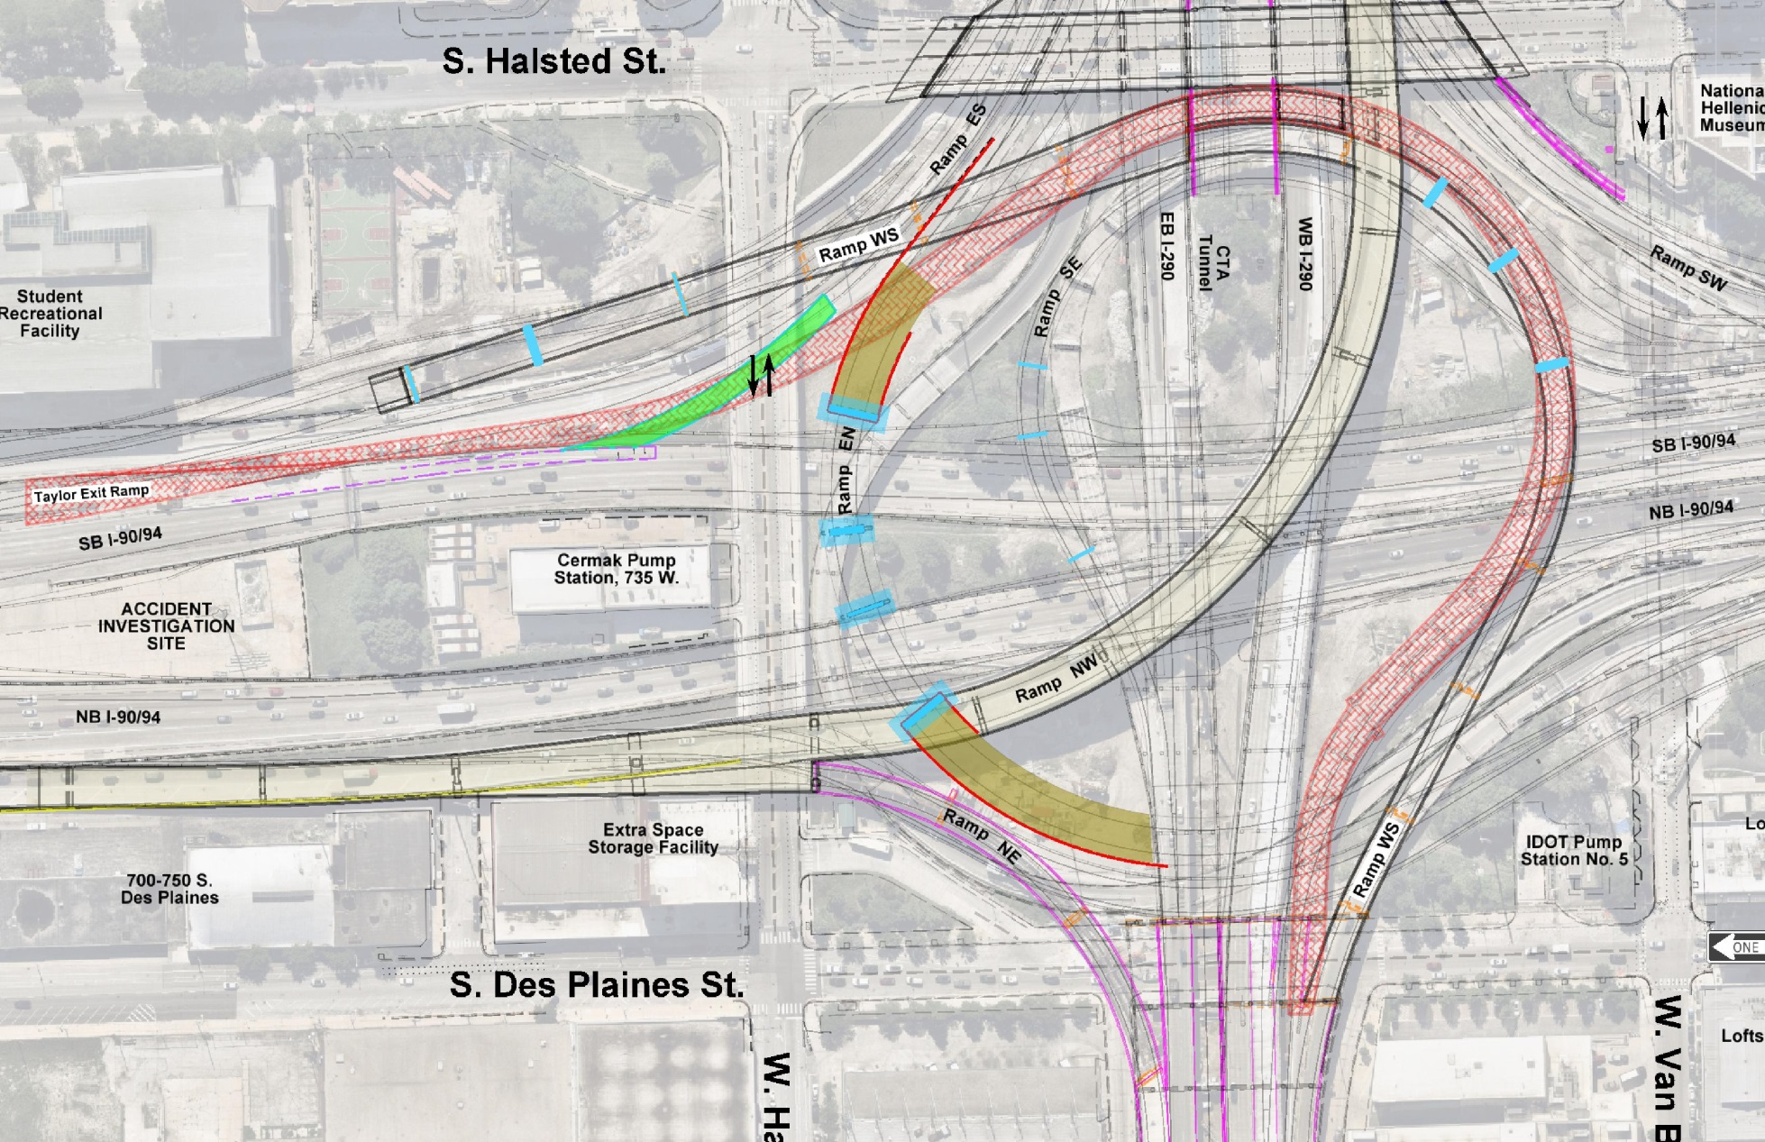
Suggested Construction Staging
Stage 1 (60X93 & 60X79) – Existing Ramp EN Open to Traffic
  Construct WS Pier 13,
  Footing and Pier Stem
  Construct Ramp WS
  Piers 6,7 & 8 (April & May 2019)
N
  Construct Ramp WS, South Abut,
  Piers 15 & 16 (Feb & March 2019)
  Construct EN West Abutment,
  RW18 & Approach Pavements
  Construct SE Piers 5,6&7
  (March to May 2019)
  Construct Temp Pavement
  for Ramp ES
  Construct EN Pier 2 & Micropiles for Pier 1
  Construct Junction
  Chamber No. 2
  Construct EN East Abutment,
  RW20, RW22B & Approach Pavements
Legend
60X93
WB I-290
EB I-290
60X79
Notes:
Contract 60X93
Ramp WS (SN 016-1715)
Begin Piers 6, 7, 8, 15, and 16
Begin and Complete Pier 13
Begin South Abutment
Ramp SE (SN 016-1714)
Begin Piers 5, 6, and 7
Contract 60X79
Ramp EN (SN 016-1712)
Begin Pier 1 and 2
Complete Pier 2
Begin East and West Abutments
Complete East Abutment
Begin Retaining Walls 18, 20, 22B, and 23
Complete Retaining Wall 20

Slide 14
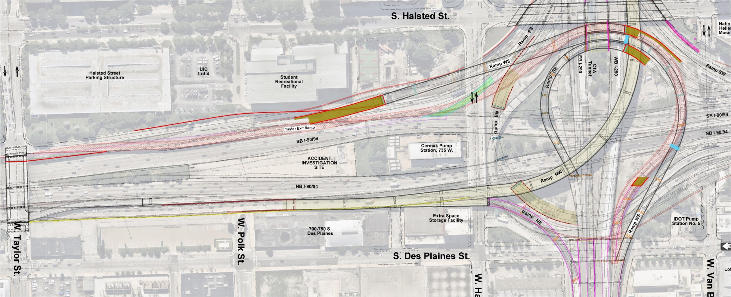
Suggested Construction Staging
Stage 2 (60X93)/Stage 1 (60X79) Cont. – Existing Ramp EN Open to Traffic
N
  Taylor Bypass
  North Abutment & RW 47
  Construct Ramp WS
  RW14 & Approach Pavements
  Construct Ramp WS
  RW16
  Construct WS Pier 9
  Construct Ramp SE
  North Abutment &
  RW 48
  Modify Existing RW12
  Construct WS Pier 4
  Construct Ramp WN
  North Abutment &
  RW 46
WB I-290
EB I-290
Legend
60X93
60X79
Notes:
Contract 60X93
Ramp WS (SN 016-1715)
Continue Piers 6, 7, 8, 15, and 16
Continue South Abutment
Begin and Complete Pier 4
Begin Pier 9
Begin Retaining Wall #14
Ramp SE (SN 016-1714)
Continue Piers 5, 6, and 7
Begin North Abutment and Retaining Wall #48 *
Contract 60X93 – Continued
EB I-90/94 Taylor Street Exit Ramp (SN 016-1718)
Begin North Abutment and Retaining Wall #47 *
Begin Retaining Wall #12 and #16
Ramp WN (SN 016-1706)
Begin North Abutment and Retaining Wall #46 *
Begin and Complete Main Drain Sewer Improvements
Contract 60X79 – Stage 1 Continued
Begin Drainage Work

Slide 15
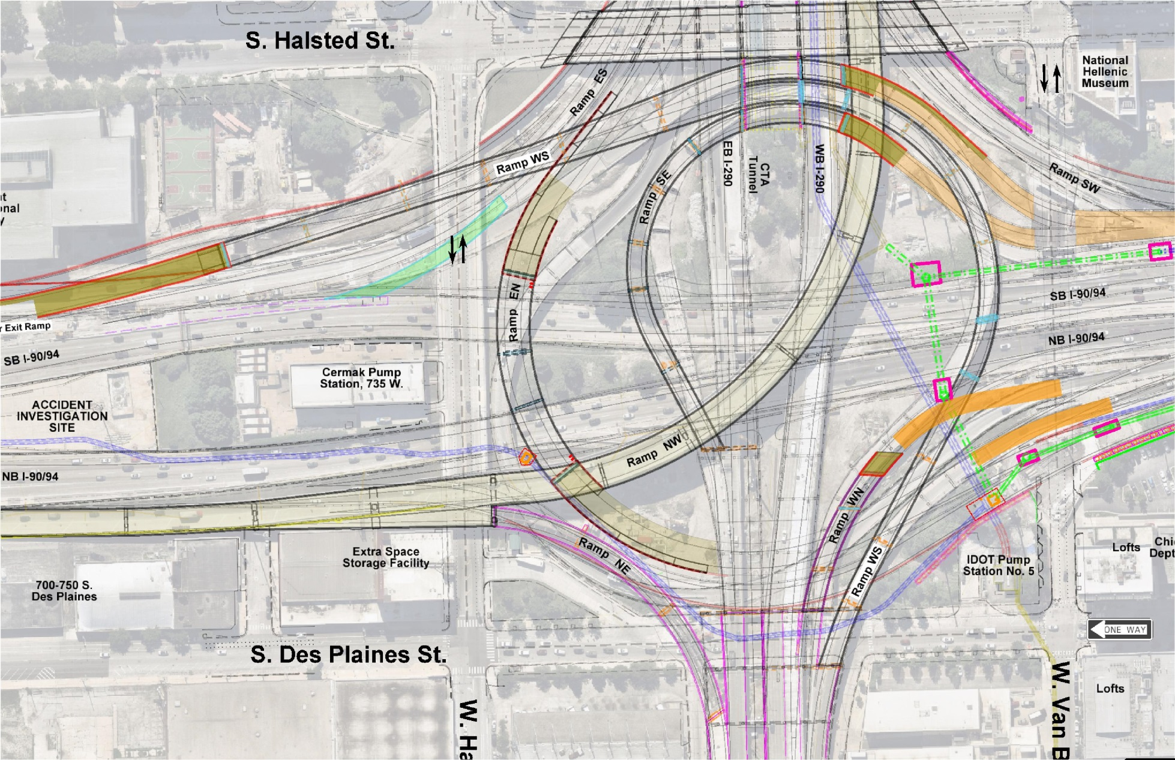
Suggested Construction Staging
Stage 3 (60X93)/Stage 1 (60X79) Cont. – Existing Ramp EN Open to Traffic
  Construct:
  Ramp WS Pier 11 & Ramp SE Pier 2
  Construct:
  Taylor Bypass Pier 1,
  Ramp WS Pier 10 &
  Ramp SE Pier 1
N
  Construct:
  Ramp SE Pier 3
  Roadway Pavement
  South Approach to
  Taylor Bypass &
  Ramp SE
  Construct:
  Ramp WS Pier 5
  Construct:
  Ramp WN Pier 2
  Junction Chamber 1
  Jacking Pits 1, 2 & 3
  Main Drain Across Kennedy
  Construct RW23
  Jacking Pits 4 & 5
  Temp Pavement at North End
Legend
60X93
WB I-290
60X79
EB I-290
Notes:
Contract 60X93
Ramp WS (SN 016-1715)
Continue Piers 6, 7, 8, 9, 15 and 16
Continue South Abutment
Continue Retaining Wall #14
Begin Piers 5, 10 and 11
Ramp SE (SN 016-1714)
Continue Piers 5, 6, and 7
Continue North Abutment and Retaining Wall #48 *
Begin Piers 1, 2, 3
Contract 60X93 – Continued
EB I-90/94 Taylor Street Exit Ramp (SN 016-1718) (Taylor Bypass)
Continue North Abutment and Retaining Wall #47 *
Continue Retaining Wall #12 and #16
Begin Pier 1
Ramp WN (SN 016-1706)
Continue North Abutment and Retaining Wall #46 *
Begin Pier 2
Contract 60X79 – Stage 1 Continued

Slide 16
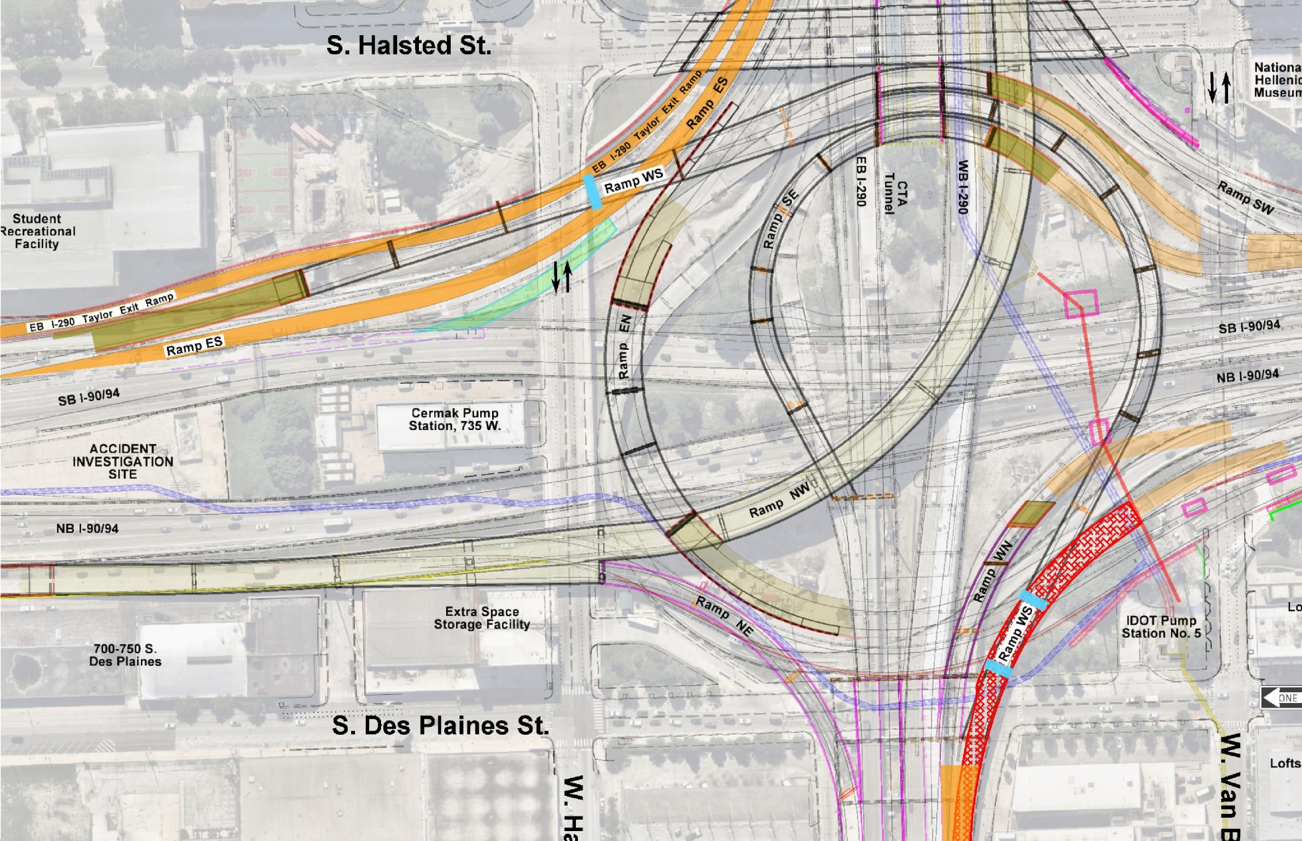
Suggested Construction Staging
Stage 4 (60X93)/Stage 1 (60X79) Complete
Existing Ramp EN Open to Traffic and Existing Ramp WN Closed to Traffic
N
  Roadway Pavement
  Ramp ES &
  EB I-290 Taylor Exit
  Construct:
  Ramp WS
  Pier 14 Footing
  Construct:
  Ramp WS
  Piers 1 & 2
Legend
  Remove Existing
  Ramp WN
60X93
  Congress Viaduct
  Deck Removal Units I & II
  Beam Removal Unit I
60X79
Notes:
Contract 60X93
Ramp WS (SN 016-1715)
Complete Pier 5
Continue Piers 6, 7, 8, 9, 10, 11, 15 and 16
Continue South Abutment
Continue Retaining Wall #14
Begin Piers 1, 2, and 14
Ramp SE (SN 016-1714)
Continue Piers 1, 2, 3, 5, 6, and 7
Continue North Abutment and Retaining Wall #48 *
Contract 60X93 - Continued
EB I-90/94 Taylor Street Exit Ramp (SN 016-1718)
Continue North Abutment and Retaining Wall #47 *
Complete Retaining Wall #12 and #16
Continue Pier 1
Ramp WN (SN 016-1706)
Continue North Abutment and Retaining Wall #46 *
Continue Pier 2
Contract 60X79 – End Stage 1

Slide 17
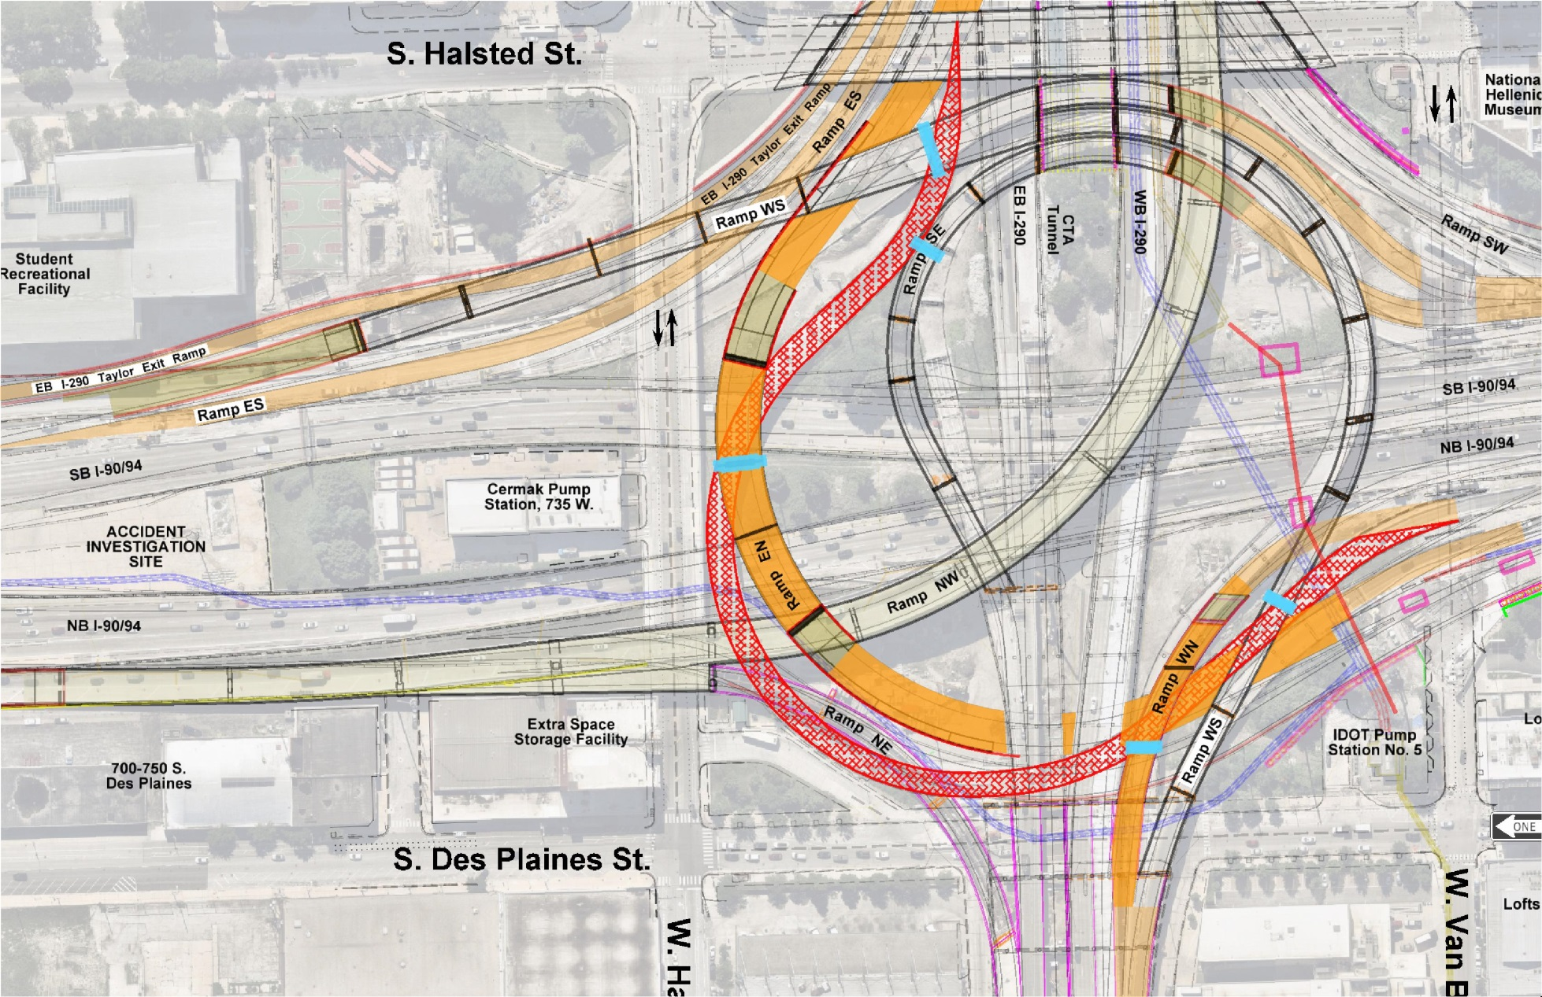
Suggested Construction Staging
Stage 5 (60X93) and Stage 2 (60X79)
Existing Ramp EN & WN Closed to Traffic
N
  Ramp WS Pier 12
  Complete RW 18 &
  Approach Pavement
  Ramp SE Pier 4
  Construct Temp Pavement
  Tie-in for WN & EN
  Complete Pier 1
  Erect Girders & Pour Deck
  Install Storm Sewer
  Below Ramps WN & EN
  Remove Ex Ramp EN Pavement, Bridge Piers & Deck
  Ramp WS Pier 3
  Complete EN Approach Pavement
  Complete RW 23
Legend
  Complete Ramp WN
  Erect Girders & Pour Deck
60X93
  Congress Viaduct
  Girders & Deck
  Ramp WN Pier 1
60X79
WB I-290
EB I-290
Notes:
Contract 60X93
Close Ramp EN as per 60X79 Detour Plan
Ramp WS (SN 016-1715)
Complete Pier 10 and 11, Retaining Wall #14, and South Abutment
Continue Piers 1, 2, 6, 7, 8, 9,14, 15 and 16
Begin Pier 3 and 12
Ramp SE (SN 016-1714)
Complete Pier 1 and 2
Continue Piers 3, 5, 6, and 7
Continue North Abutment and Retaining Wall #48 *
Begin Pier 4
EB I-90/94 Taylor Street Exit Ramp (SN 016-1718)
Continue North Abutment and Retaining Wall #47 *
Complete Pier 1
Ramp WN (SN 016-1706)
Complete North Abutment and Retaining Wall #46 *
Complete Pier 2
Begin and Complete Pier 1
Complete within 25 calendar days after existing Ramp EN closure
Begin and Complete Superstructure
Contract 60X79 – Stage 2
Ramp EN (SN 016-1712)
Close Existing Ramp EN as per Detour Plan
Complete Pier 1
Complete West Abutment
Complete Retaining Walls 18 and 23
Continue Retaining Wall 22B
Install storm sewer across Ramp EN and Ramp WN

Slide 18
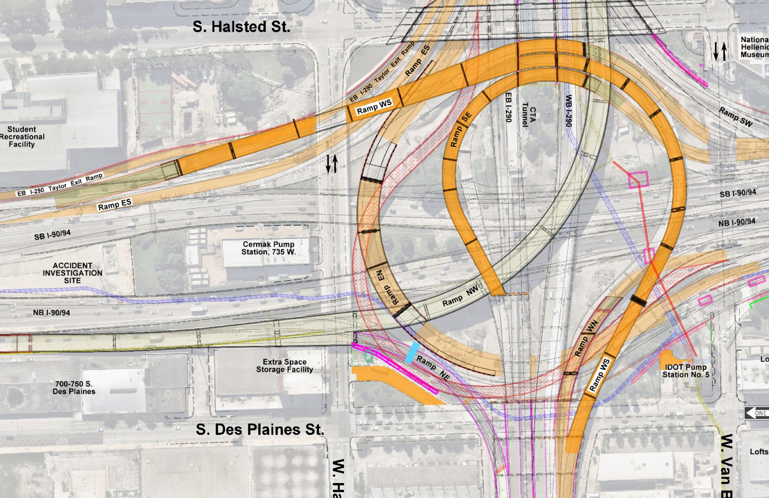
Suggested Construction Staging
Stage 6 (60X93) and Stage 3 (60X79)
Existing Ramp EN & WN Closed to Traffic
N
  Erect Girders & Deck for Ramp WS. SE &
  Taylor Bypass
  Remove Remaining
  Portions of Ex Ramp EN
  Construct Pump
  Station 5 Pavement
  Complete RW22A & RW22B
  Construct Ramp NE Pier 1 Extension & CTA Bus Turnaround
Legend
60X93
WB I-290
EB I-290
60X79
Notes:
Contract 60X93
Ramp WS (SN 016-1715)
Complete Piers 1, 2, 3, 6, 7, 8, 9, 12, 14, 15 and 16
Begin and Complete superstructure
Ramp SE (SN 016-1714)
Complete Piers 3, 4, 5, 6, and 7
Complete North Abutment and Retaining Wall #48 *
Begin and Complete superstructure
EB I-90/94 Taylor Street Exit Ramp (SN 016-1718)
Complete North Abutment and Retaining Wall #47 *
Begin and Complete superstructure
Contract 60X79 – Stage 3
Ramp EN (SN 016-1712)
Complete Retaining Wall 22B
Begin and complete Retaining Wall 22A
Begin and complete CTA Building Demo
Begin and complete Ramp NE (SN 016-1839) Pier Extension

Slide 19
Contract 60X93 & 60X79
Ramp Closure Considerations
For Both Contracts - See STAGING AND INTERCHANGE RESTRICTIONS Special Provisions
Contract 60X93
  Ramp WS
    Existing – Allowable closure after demolition plans are approved.
    Proposed - Fully open to traffic on or before December 1, 2020.
  Ramp SE (Already Closed and Demolished by Others)
    Proposed - Fully open to traffic on or before December 1, 2020.
  Ramp WN
    Existing – Closure on or after January 1, 2020; coordination with Contract 60X79.
    Proposed – Fully open to traffic 240 calendar days after closure – open with Ramp EN (60X79).
  EB I-90/94 Taylor Street Exit Ramp
    Existing – Closure on or after July 9, 2019.
    Proposed - Fully open to traffic on or before December 1, 2020.
  EB I-290 Taylor Street Exit Ramp
    Existing - Closed in conjunction with or after EB I-90/94 Taylor Street Exit Ramp.
    Proposed – Available by May 1, 2020 to support Contract 60X79 Ramp EN detour.
Contract 60X79 –
  Ramp EN
    120 consecutive calendar day closure period – See INCENTIVE/DISINCENTIVE PAYMENT PLAN

Slide 20
Contract 60X93 & 60X79
Work Area Considerations
For Both Contracts - See AVAILABLE WORK AREAS AND SEQUENCING REQUIREMENTS
Contract 60X93 –
  Substructure Construction Restricted Until Others Have Completed All or Portions of Work
    13 Piers , 2 abutments and 2 retaining walls
  One pier is required to be partially completed early to allow Contract 60X79 retaining wall work to proceed
  Two piers need to be started and completed in a specific timeframe
Contract 60X79 –
  Retaining Wall No. 23 Must Be Built During 240 Day Ramp WN Closure (60X93)

Slide 21
Contract 60X79 and 60X93
CTA Coordination
60X79
  CTA FLAGGING AND COORDINATION Special Provision
  Closure of CTA Bus Turnaround Facility on or after July 1, 2020 for building demolition, excavation and pavement/lighting reconstruction
60X93
  CTA FLAGGING AND COORDINATION Special Provision
  Entry into CTA Operating Area – Access from WB I-290 (Contract 60X77)
  Installation, Maintenance and Removal of CTA PROTECTIVE SHIELD
  Pier Construction Immediately Adjacent to Existing CTA Retaining Walls
  CTA Requests Staging Flaggers/Inspectors Near Walls and Inside Tunnels During Major Adjacent Work

Slide 22
Contract 60X79 & 60X93
Major Special Provision Considerations
CONSTRUCTION VIBRATION MONITORING and MONITORING ADJACENT STRUCTURES
  Monitoring Program of Various Sensitive Nearby Buildings, Structures, Tunnels and Other Locations
TEMPORARY SOIL RETENTION SYSTEM
  Temporary Soil Retention System Must Be Installed Without the Use of Impact-Type Pile Drivers
KEEPING THE EXPRESSWAY OPEN TO TRAFFIC
  Requirements for Mainline/Ramp Lane Closures
FOUNDATION DRILLING PROCEDURES
  Identifies Specific Requirements Adjacent to CTA Retaining Wall (60X93) and at Abandoned Tunnel Locations (60X79)
PERMITS
  Identifies the requirements for approval by the City of Chicago Office of Underground Coordination (OUC)
Noise & Dust Control Compliance

Slide 23
Contract 60X79 & 60X93
Utilities Coordination
See STATUS OF UTILITIES Special Provisions for Details
Contract 60X79 Highlights
  IDOT Pump Station #5
    AT&T - Telephone pole within the limits of temporary driveway access to Pump Station #5 to be relocated by AT&T and IDOT.
  Ramp EN Pier #1
    AT&T and ComEd - Combined duct Package located below I-90/94 just north of Harrison Street. Construction of Ramp EN Pier 1 temporary soil retention system (TSRS) to span over duct package. See duct test hole survey information in bridge plans.
  Retaining Wall 22A
    AT&T and ComEd - Combined duct package located below I-90/94 just north of Harrison Street. Retaining Wall 22A TSRS to be designed to span over duct package.

Slide 24
Contract 60X79 & 60X93
Utilities Coordination
See STATUS OF UTILITIES Special Provisions for Details
Contract 60X93 Highlights
  Ramp WS Piers 10 & 11; Ramp SE Piers 1 & 2; SB Exit to Taylor Pier 1
    CTA – The Contractor shall protect the active railroad facilities from damage during construction.
  EB I-290 Exit to Taylor / Ramp ES
    ComEd - 24 Duct Package located just north of Harrison Street. ComEd will relocate cables and remove a portion of the duct package’s top row and wood encasement and install a steel plate directly on top.
    AT&T – 48 Duct Package located just north of Harrison Street. AT&T will remove wood encasement from the top of the duct package and install a steel plate directly on top for a portion of the length.
    AT&T – Extreme care shall be used during installation of the soil retention system to support the construction of Ramp WS Pier 14. All excavation, including soil retention system shall be coordinated with AT&T.

Slide 25
Contract 60X79 & 60X93
Combination Bids
Pursuant to Illinois Administrative Code, Title 44, Section 6.190 – Combination Bids for Construction Contracts
Contract 60X79 and Contact 60X93 can be submitted together as a combination bid. If a combination bid is submitted, an individual item bid must also be submitted for each individual item. Failure to include an individual bid for each of these items and a combination bid amount will cause the combination bid to be declared irregular.

Slide 26
DBE/Diversity Program
DBE Goals:
    60X79 – 21.00%
    60X93 – 15.00%
DBE Contact: Gideon E. Charles
        Contract Compliance Officer
        District 1/EEO/Contract Compliance
IDOT District 1 - Resource Center
    Current Location through Nov. 2018
    1253 S. Halsted Street
    Chicago, IL. 60607
    Phone: (312) 939-1100
    New Location in November/December 2018
    Multi Modal Resource Center
    2121 W. Taylor Street, 5th Floor
    Chicago, IL 60612
    Phone: (312) 939-1100

Slide 27
DBE/Diversity Program
Trainees Program – HCCTP Program:
    Dawson Technical College
    Willie Shepard
    Phone: (773) 487-6940
    Alex Smith
    South Suburban College
    Phone: (708) 596-2000, Ext. 3257
Trucking Requirements
Typical DBE Work

Slide 28
Questions
  Submit questions using the IDOT Website:
  DOT.ChiefContractOfficial@illinois.gov

Slide 29
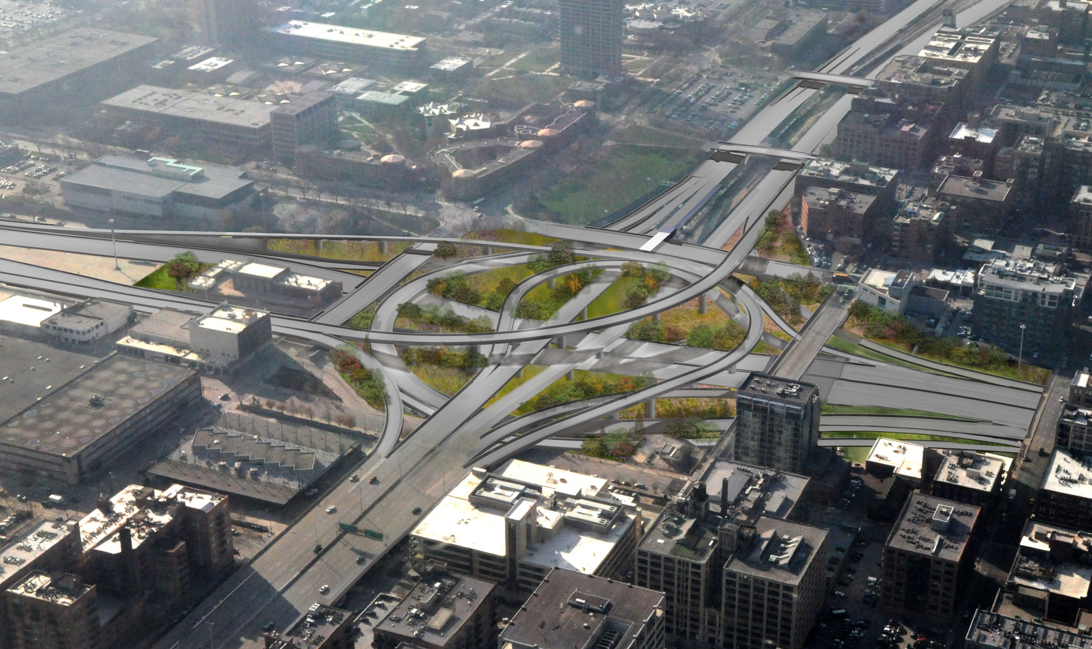
Contract 60X79 & 60X93
Questions / Comments
Thank You

