Slide 1
Pre-Bid Meeting for Litter Picking Contracts
Contract Numbers: 62K36 to 62K48

Slide 2


Traffic Control Required for Shoulder Work

Slide 3


Traffic Control signs for Ramp Work

Slide 4
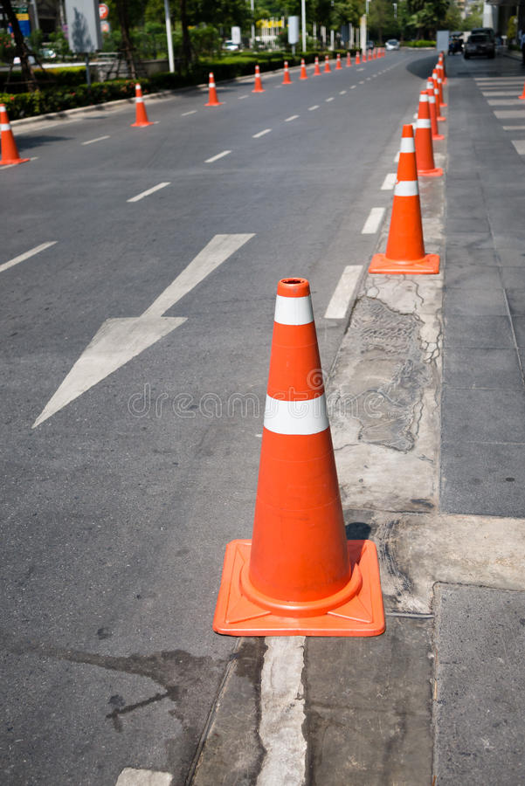

Cones required for Traffic Control

Slide 5
Traffic Control Set up/ Tear Down
Setting up a closure should be signs first and then cones for the work zone
Tear down should be opposite, take cones down first then signs

Slide 6
Traffic Control Closure Request
A shoulder closure must be requested daily on the IDOT Lane Closure System
Lane closure must be requested by 9:00am the day prior
If Lane closure requests are not submitted on time or not approved by Traffic Operations. The Contractor will not be allowed to work that day.

Slide 7
Litter Picking Times
Work Zone Days
Sunday – Saturday
Work Zone Times
Monday – Friday 9:00am to 3:00pm
Saturday & Sunday vary upon request

Slide 8
Work Zone Limits/Access
The Shoulder should only be used for parking and accessing your vehicles
Labor force should not walk down the shoulder that has not been signed and coned off as a work zone

Slide 9
Vehicle on work site
No personal vehicles
All trucks must have flashing beacon (amber strobe light)
Company name must be displayed on Truck
Parking on shoulder if necessary
Parking should primarily be off the pavement

Slide 10
Areas to be Litter Picked
Grass areas from edge of paved shoulder to pedestrian barrier (fence)
Grass areas from main roadway including both sides of ramp to pedestrian barrier (fence).
Grass areas that are between ramps, Accident investigation Sites, along bridges and embankments are all considered incidental and paid for within the Expressway Linear Mile measurements.

Slide 11
Areas we do not want the contactor to go:
Live lanes of traffic
On live ramps or ramp shoulders
Dangerous locations that require additional lane closures
Standing water deeper than 6” deep
In heavy brush taller than 3’ tall

Slide 12
Work Order Process
Before any work can begin, a Work Order must be processed, signed by the Resident Engineer and acknowledgement of receipt by the contractor.
Once a Work Order has been signed and sent, the contractor has 14 days to complete the area noted on the Work Order. (see calendar for examples)
If a Work Order is not completed within the required timeframe, a penalty of $5000/day will be assessed.
If there is weather events or other factors that keep the contractor from working on any given day during the 14 day, a request for a time extension must be submitted by the contractor with reasoning. If no Time extension is submitted, the RE will proceed with the Liquidated damages for areas not completed within the 14 days.

Slide 13
Payment schedule
When a Work Order has been completed to the satisfaction of the District a pay estimate will be put together. A meeting with the contractor will need to be set up to sign paperwork to agree on Quantities. Once all paperwork and Quantities are done a pay request will be processed.

Slide 14
Daily Schedule and Work Complete
A daily schedule must be submitted no later than 6:30am every morning.
A daily work complete must be submitted by 6:30am the following day.
If a daily schedule or work complete has not been submitted, the contractor will not be allowed to work that day and will be charged with that day and will not receive a reprieve for that day if requested.
Keep the inspector and RE in the loop through out the day. If there is a change in the location or availability of the areas to be worked on or changes in times (show up or Leaving). Its best to contact the RE and/or the inspector and inform them of the changes.

Slide 15
Process for Picking Litter
All Litter Picking as explained in Sec 2 paragraph F in the contract will need to be removed from the areas specified in the Work Order.
All Litter/Rubbish/collection bags must be removed from the Expressway at the end of every workday and disposed of properly as stated in the contract.
If any work areas are rejected, you will be notified verbally and in writing. You will have 24 hours to complete the work to the satisfaction of the inspector and Engineer. If the work is not successfully cleaned as requested no time will be added to the completion date. All outstanding items must be completed within the 14-day time frame as stated in the Specifications.

Slide 16
Safety
All Equipment used for the purpose of Litter Picking on the Expressway must have high intensity amber strobes, headlights and flasher must be on while working.
All personnel working under this contract will be required to wear approved Flagger vest when not in a vehicle.
At no time will any construction personnel enter the live lane of traffic.
At no time should construction personnel walk along the live lane of traffic without the proper shoulder closure and equipment.
Before any Work Orders will be issued, an inspection of safety equipment, including signs, cones, strobes and vest will be conducted. As long as everything meets the minimum requirements, we will proceed with issuing Work Orders for the projects.

